Slide 1
MIDTERM PROJECT
Zhengwu Zhang
Feb. 28, 2010

Slide 2

Problem Statement:
Given a noisy images, prior probability model
and estimate the posterior density
Prior Model:
Observation Model:
Both I and W are Normal distribution

Slide 3

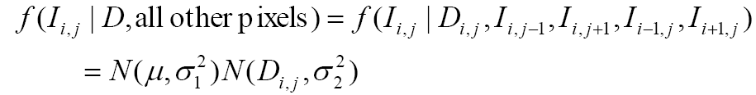

Posterior Density:
Two Gaussian Product is another Gaussian :
Know the f(I|D)

Slide 4
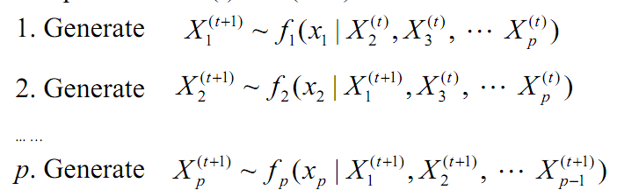
How to sample from f(I|D)
We already know the full conditional,
So use the Gibbs sampler
Sequentially generate X(t)

Slide 5
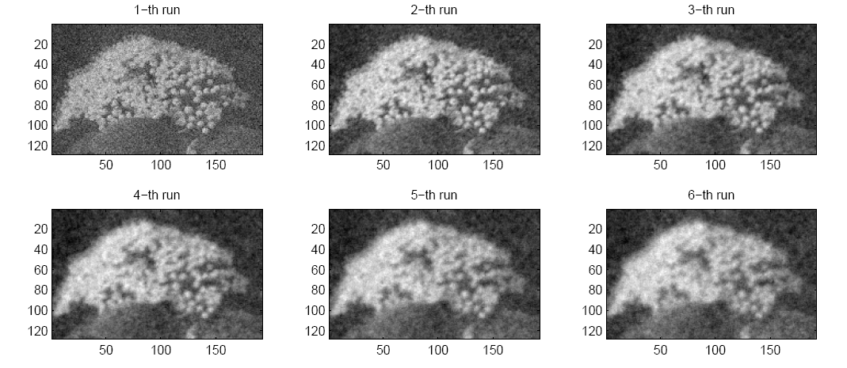

Experiment Results:

Slide 6
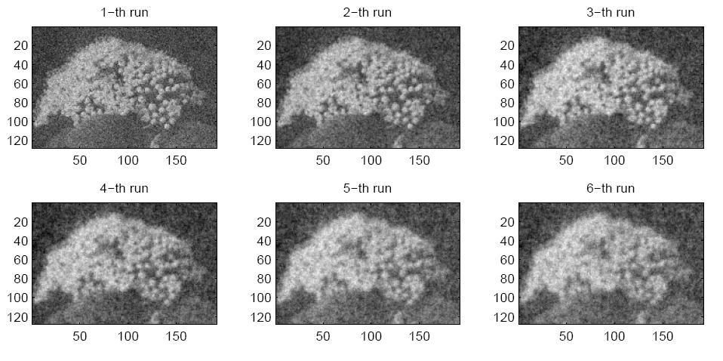

Experiment Results:

Slide 7
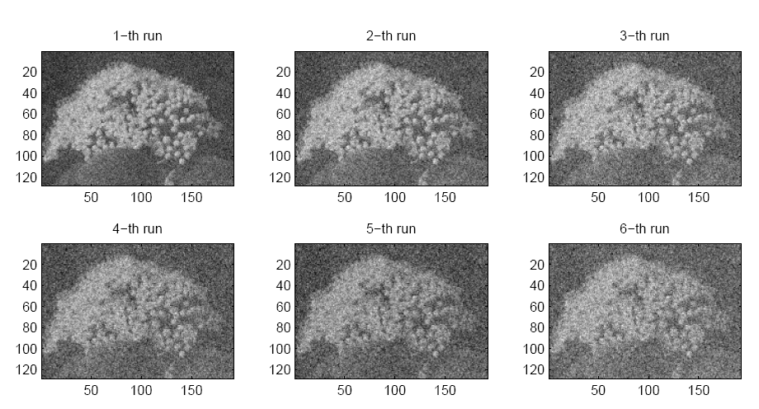

Experiment Results:

Slide 8
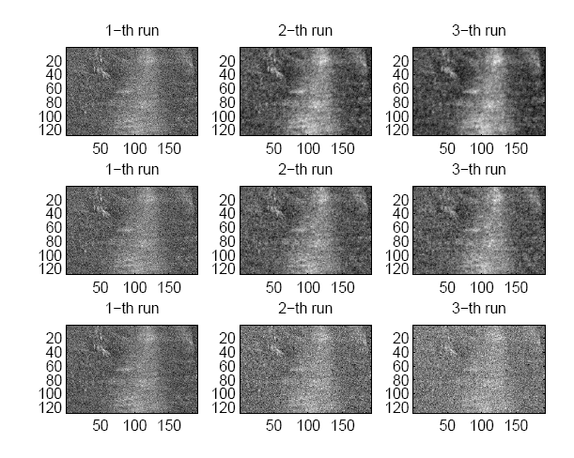
Experiment Results:

Slide 9
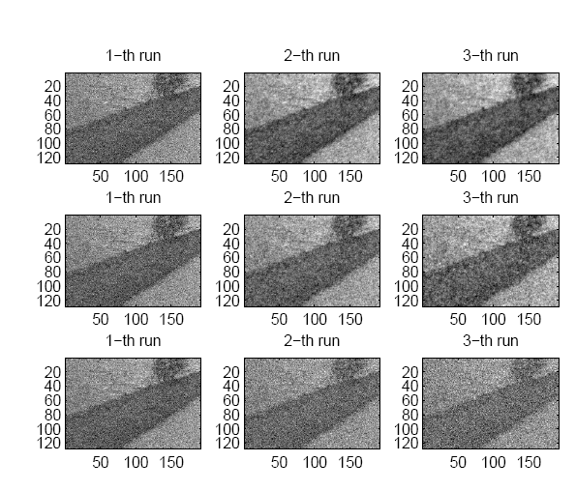
Experiment Results:

Slide 10
Experiment Results:
With the increasing of prior variance,
the posterior Density are getting worse.
Why?
2. Due to the model we are choosing, The posterior
resampling is actually a kind of Gaussian Smoothing
Why?

Slide 11
Experiment Results:
With the increasing of prior variance,
the posterior Density are getting worse.
Why?
2. Due to the model we are choosing, The posterior
resampling is actually a kind of Gaussian Smoothing
Why?

Slide 12
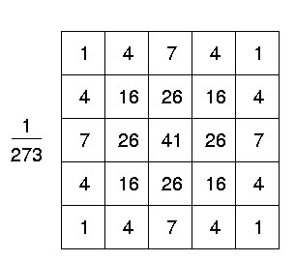
Gaussian Smoothing:
Gaussian Smoothing realized by Gaussian Kernel:
0 | I1 | 0
I2 | Dij | I4
0 | I3 | 0

Slide 13
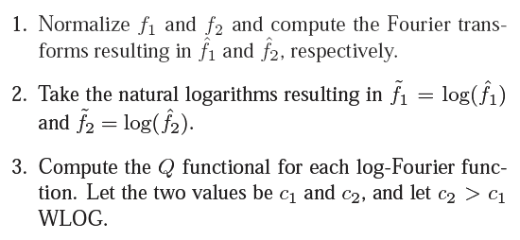
Compute Blurring Parameter:
By using Blurring invariant Riemannian Metrics

Slide 14
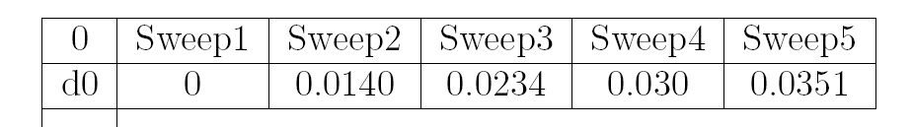
Experiment Results:
Gaussian Blurring parameter between the observation
image and the posterior Resampling image

Slide 15
Thank you!

